Slide 1
Banking Customer
Term Deposit Prediction
-Srinath Mugundhan

Slide 2
INTRODUCTION
It is a philosophy whose main focus is providing customer satisfaction. Marketing is the activity, set of institutions, and process for creating, communicating, delivering, and exchanging offerings that have value for customers, clients, partners and society at large. Also in simple terms all of the activities that help business reach their target market effectively
Problem Statement
Identify the Campaign effectiveness for Term Deposit
Hypothesis
Right customers are not being targeted for Term Deposit Campaign
Lead Generation for Marketing team

Slide 3
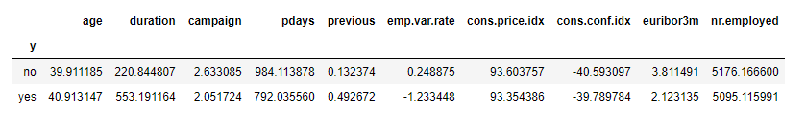
Descriptive Analysis
Mean Age is approximately 40 years old. (Minimum: 17 years old and Maximum: 98 years old)
The average age of customers who bought the term deposit is higher than that of the customers who didn't.
The pdays (days since the customer was last contacted) is understandably lower for the customers who bought it. The lower the pdays, the better the memory of the last call and hence the better chances of a sale.
Surprisingly, campaigns (number of contacts or calls made during the current campaign) are lower for customers who bought the term deposit.
The mean cons.conf.idx is -40.50. However, the Standard Deviation (std) is a high number so we can understand through this that the cons.conf.idx is heavily distributed across the dataset.

Slide 4
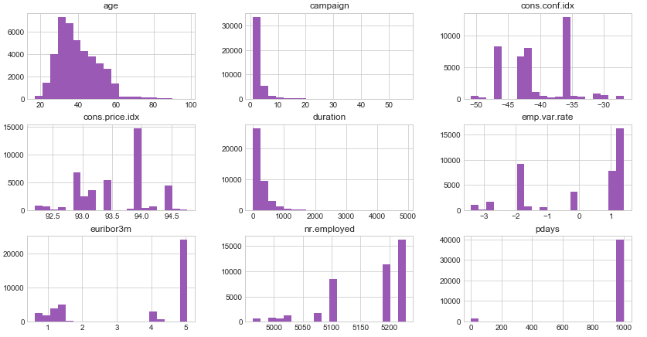
Univariate Analysis -Distribution

Slide 5
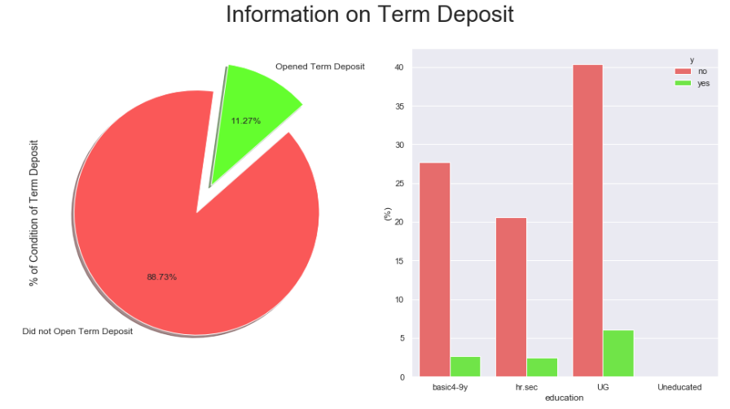
Term Deposit Multivariate Analysis

Slide 6
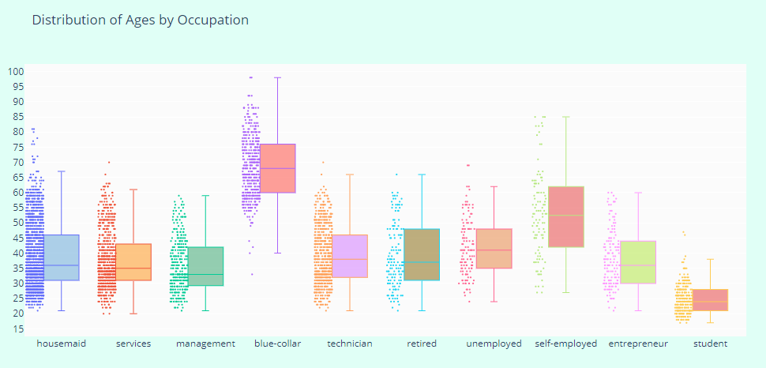
Analysis Of Occupation
Number of Occupations: Management is the occupation that is more prevalent in this dataset.
Age by Occupation: The blue coloured are the ones who have the highest median age while student are the lowest.
Balance by Occupation: Entrepreneurs and Retirees are the ones who have the highest balance in their accounts.
The frequency of purchase of the deposit depends a great deal on the job title. Thus, the job title can be a good predictor of the outcome variable.

Slide 7
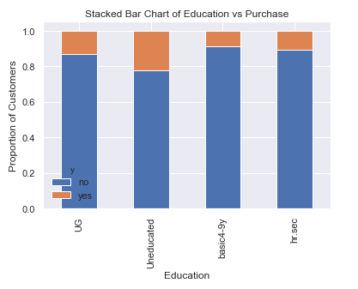
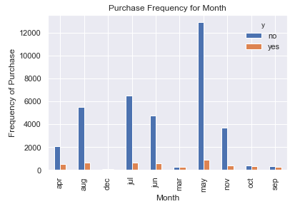
Analysis of Education and Month

Slide 8
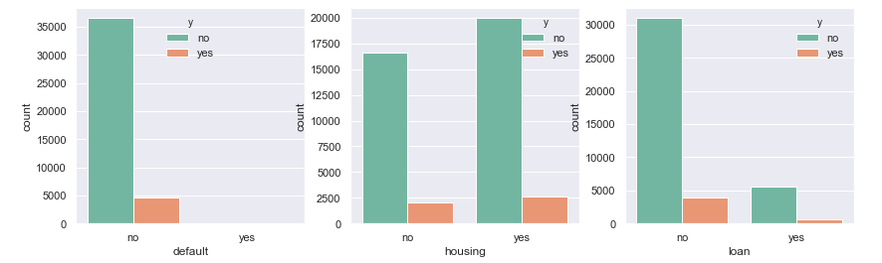
Analysis of Default, Housing, loan and Term Deposit
Interesting pattern at Default variable. Clients with no defaulter tend to say "no" for the term deposit.

Slide 9
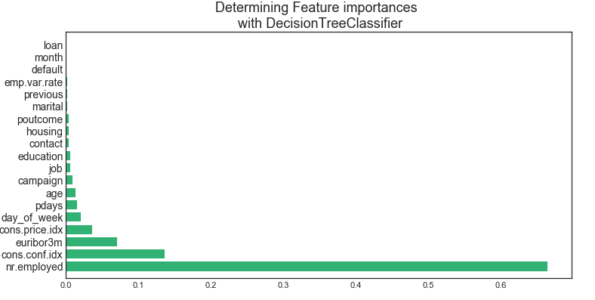
Feature Importance
Micro Level Feature Identified
The Recursive Feature Elimination (RFE) has helped us select the following features: 'campaign', 'pdays', 'emp.var.rate', 'cons.price.idx', 'cons.conf.idx', 'euribor3m', 'nr.employed', 'balance', 'education_UG', 'education_basic4-9y', 'job_blue-collar', 'age_(18, 30]', 'age_(30, 49]', 'marital_single','contact_cellular','contact_telephone', 'month_may', 'balance_middle'

Slide 10
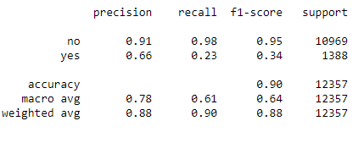
Model Validation
Precision and Recall
Interpretation:
Of the entire test set, 88% of the promoted term deposit were the term deposit that the customers liked. Of the entire test set, 90% of the customer's preferred term deposit were promoted.

Slide 11
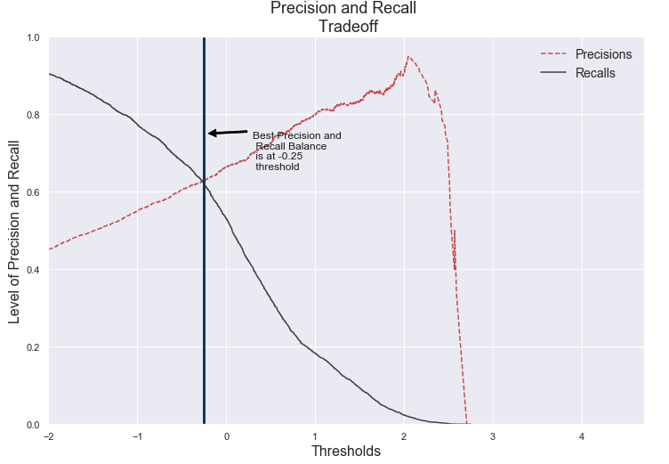
Trade Off Curve
As the precision gets higher the recall gets lower and vice versa. For instance, if we increase the precision from 30% to 60% the model is picking the predictions that the model believes is 60% sure. If there is an instance where the model believes that is 58% likely to be a potential client that will subscribe to a term deposit then the model will classify it as a "No." However, that instance was actually a "Yes" (potential client did subscribe to a term deposit.) That is why the higher the precision the more likely the model is to miss instances that are actually a "Yes"

Slide 12
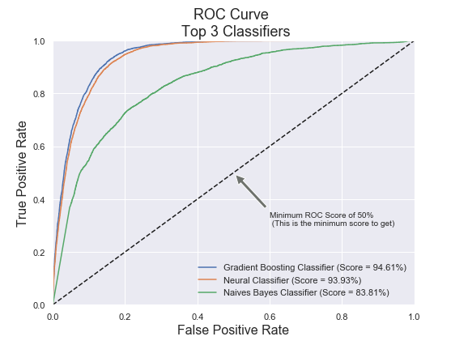
ROC Curve Comparative Study with Other Models
The ROC curve tells us how well our classifier is classifying between term deposit subscriptions (True Positives) and non-term deposit subscriptions. The X-axis is represented by False positive rates (Specificity) and the Y-axis is represented by the True Positive Rate (Sensitivity.) As the line moves the threshold of the classification changes giving us different values. The closer is the line to our top left corner the better is our model separating both classes

Slide 13
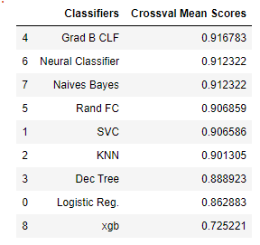
Models Scores and Consider Model for Final
Note :
Have taken multiple Model into consideration and finally sticking with Gradient boosting classifier as it gives better trade off and Accuracy

Slide 14
Solutions for the Next Marketing Campaign - Conclusion
1) Months of Marketing Activity: We saw that the month of highest level of marketing activity was the month of May. However, this was the month that potential clients tended to reject term deposits offers (Lowest effective rate: -34.49%). For the next marketing campaign, it will be wise for the bank to focus the marketing campaign during the months of March, September, October and December. (December should be under consideration because it was the month with the lowest marketing activity, there might be a reason why december is the lowest.)
2) Seasonality: Potential clients opted to subscribe term deposits during the seasons of fall and winter. The next marketing campaign should focus its activity throughout these seasons.
3) Campaign Calls: A policy should be implemented that states that no more than 3 calls should be applied to the same potential client in order to save time and effort in getting new potential clients. Remember, the more we call the same potential client, the likely he or she will decline to open a term deposit.
4) Age Category: The next marketing campaign of the bank should target potential clients in their 20s or younger and 60s or older. The youngest category had a 60% chance of subscribing to a term deposit while the eldest category had a 76% chance of subscribing to a term deposit. It will be great if for the next campaign the bank addressed these two categories and therefore, increase the likelihood of more term deposits subscriptions.
5) Occupation: Not surprisingly, potential clients that were students or retired were the most likely to subscribe to a term deposit. Retired individuals, tend to have more term deposits in order to gain some cash through interest payments. Remember, term deposits are short-term loans in which the individual (in this case the retired person) agrees not to withdraw the cash from the bank until a certain date agreed between the individual and the financial institution. After that time the individual gets its capital back and its interest made on the loan. Retired individuals tend to not spend bigly its cash so they are more likely to put their cash to work by lending it to the financial institution. Students were the other group that used to subscribe term deposits. 6) House Loans and Balances: Potential clients in the low balance and no balance category were more likely to have a house loan than people in the average and high balance category. What does it mean to have a house loan? This means that the potential client has financial compromises to pay back its house loan and thus, there is no cash for he or she to subscribe to a term deposit account. However, we see that potential clients in the average and high balances are less likely to have a house loan and therefore, more likely to open a term deposit. Lastly, the next marketing campaign should focus on individuals of average and high balances in order to increase the likelihood of subscribing to a term deposit.
7) Develop a Questionnaire during the Calls: Since duration of the call is the feature that most positively correlates with whether a potential client will open a term deposit or not, by providing an interesting questionnaire for potential clients during the calls the conversation length might increase. Of course, this does not assure us that the potential client will subscribe to a term deposit! Nevertheless, we don't loose anything by implementing a strategy that will increase the level of engagement of the potential client leading to an increase probability of subscribing to a term deposit, and therefore an increase in effectiveness for the next marketing campaign the bank will execute. 8) Target individuals with a higher duration (above 375): Target the target group that is above average in duration, there is a highly likelihood that this target group would open a term deposit account. The likelihood that this group would open a term deposit account is at 78% which is pretty high. This would allow that the success rate of the next marketing campaign would be highly successful.
By combining all these strategies and simplifying the market audience the next campaign should address, it is likely that the next marketing campaign of the bank will be more effective than the current one.

